Slide 1

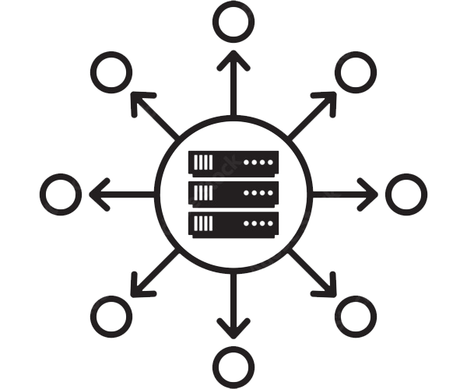

Slide 2
About today…
Redux
Middleware
Asynchronous Actions

Slide 3

Redux
Middleware, Asynchronous actions

Slide 4
Introduction to Middleware
Definition
A way to extend Redux with custom functionality
Purpose
They sit between an action being dispatched and the action reaching the reducer
Examples
Logging actions and state changes
Sending crash reports
Performing asynchronous operations like API calls

Slide 5
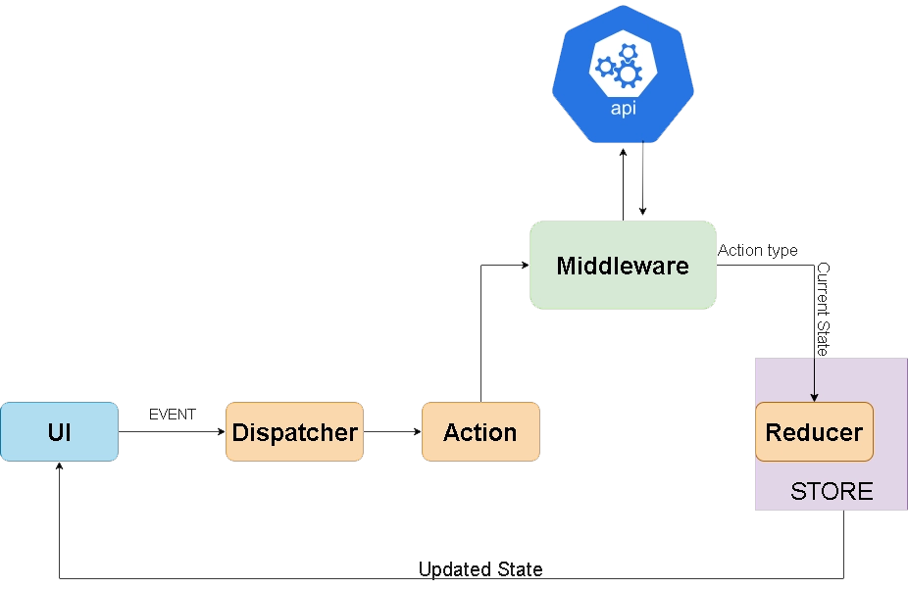
How Middleware works?
Definition
A way to extend Redux with custom functionality
Explanation
Middleware can intercept actions before they reach the reducers
Middleware can perform tasks such as logging,
making API calls, or modifying actions

Slide 6
Understanding Asynchronous Actions
Synchronous vs Asynchronous
Synchronous Actions
Dispatched actions that are processed immediately
(e.g., incrementing a counter)
Asynchronous Actions
Actions that involve a delay or wait time (e.g., fetching
data from a server)
Need for Asynchronous Actions
Handling operations that take time, such as API calls, timeouts, and user interactions
Ensuring the application remains responsive while waiting for these operations to
complete

Slide 7
Common Middleware Libraries
Redux Thunk
Allows writing functions that return other functions for handling asynchronous logic
Redux Saga
Uses generator functions to manage more complex side effects
Redux Logger
Logs every action and state change, useful for debugging
Others
Redux Observable, Redux Promise, etc

Slide 8
Intro to Redux Thunk
What is Redux Thunk
Allows writing functions that return other functions for handling asynchronous logic
The returned function receives the dispatch method as an argument and can dispatch actions asynchronously
Benefits
Simple to implement and use
Effective for handling basic asynchronous actions

Slide 9

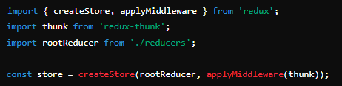
Installing Redux Thunk
Command
Setup in Store

Slide 10
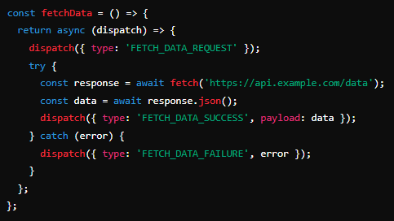
Writing Thunk Action Creators
Example
Explanation
The action creator fetchData returns a function instead of an action
Inside this function, dispatch is used to handle different stages of the asynchronous operation
(request, success, failure)

Slide 11
Handling Asynchronous Actions
Action Types
FETCH_DATA_REQUEST
Indicates that data fetching has started
FETCH_DATA_SUCCESS
Indicates that data fetching was successful
FETCH_DATA_FAILURE
Indicates that there was an error during data fetching
Reducers
Initial state setup
Different cases for each action type in the reducer

Slide 12
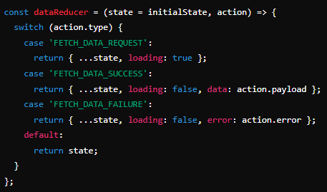
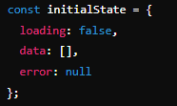
Example of Asynchronous Action Handling
Code Example
Explanation
The reducer manages different states (loading, success, failure) based on the dispatched action types
loading
Indicates the application is fetching data
data
Stores the fetched data
error
Stores any error that occurred during the fetch

Slide 13

What is middleware in Redux?
A way to extend Redux with custom functionality, allowing you to handle actions before they reach the reducers
Name one common middleware library used with Redux for handling
asynchronous actions
Redux Thunk
What are the three common action types used when handling asynchronous actions?
Request, Success, and Failure
What command do you use to install Redux Thunk?
npm install redux-thunk
In which part of the Redux setup do you apply middleware like Redux Thunk?
When creating the Redux store, using applyMiddleware

Slide 14


Slide 15

Task
To create a simple application that fetches data from a public API and displays it using Redux Thunk to handle asynchronous actions

